Slide 1

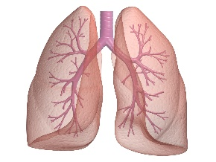

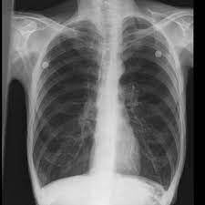
Interactive Cases
(COPD)
For
5th Year Medical Students

Slide 2
Case (1): (First Aid for USEMLE step 2 CK, 2nd edition, case (5) pp 466)
A 75-year-old man presents to his primary care physician complaining of decreased exercise tolerance and shortness of breath. He has a 50-pack-year history of smoking cigarettes. He describes his symptoms being persistent despite quitting smoking 3 years ago.
On chest examination, he has a barrel-shaped chest. On auscultation, vesicular breath sounds with prolonged expiration with bilateral expiratory wheezes was detected. Cardiac examination is normal with no jugular venous distention.

Slide 3
He has an oxygen saturation of 93% by pulse oximetry and an arterial blood gas analysis that reveals pH 7.37, PCO₂ 58 mm Hg, PO₂ 65 mm Hg, and HCO₃ 35 mEq/L. An x-ray film of the chest reveals hyperinflation and subpleural blebs.

Slide 4
Results of pulmonary function tests (PFTs) are as follows:
FEV1: 1.50 L (65% of predicted),% FEV1 change Post bronchodilator 9%.
FEV1/FVC: 60% predicted
DLCO: 14 mL/min/mm Hg (65% predicted)

Slide 5
Q1: What is the most likely diagnosis?
COPD
Interstitial Lung Disease (ILD)
Left-sided Heart Failure
Lobar Pneumonia

Slide 6
Q2: Which of the following tests was the diagnostic test for such a case?
CXR
ABG analysis
Saturation by pulse oximetry
Spirometry

Slide 7
Q3: What is the appropriate therapeutic regimen for this patient in the current time?
Antibiotic therapy.
Short-acting inhaled bronchodilators.
Long-acting inhaled bronchodilators.
Oxygen Therapy.

Slide 8
Q4: Which non-pharmacological intervention is the most effective in stopping/delaying progression in COPD patients?
Exercise limitation
Smoking cessation
Breathing exercises
Annual influenza vaccine

Slide 9
Case (2):
A 58-year-old male was admitted to the hospital after 1 week of dyspnea and cough. He was seen by a staff physician at outpatient clinic and was diagnosed with a COPD exacerbation. He was prescribed azithromycin but has not improved after 3 days of antibiotics. He has a history of dyslipidemia, COPD, alcoholic liver cirrhosis, and HTN. He routinely takes lisinopril, atorvastatin, tiotropium, and fluticasone/salmeterol, and has recently had a heavier reliance on his rescue albuterol inhaler. Review of systems reveals cough (sometimes productive) and dyspnea (worse than baseline).

Slide 10
Vitals signs:
Heart rate: 110 bpm Blood pressure: 140/86
Respiratory rate: 25bpm Temp: 37 ° C.
Oxygen saturation: 84% on room air

Slide 11
Physical Examination
General: Patient is conscious, BMI 20
Head and Neck: central cyanosis
Resp: rhonchi and wheezes heard throughout
Card: regular rate and rhythm, no murmurs, rubs, or gallops
Abd: slightly distended Neuro: slightly altered, but baseline
Ext: lower limbs edema Skin: excoriated, otherwise normal

Slide 12
Laboratory Investigations
WBCs | 15.000/mm³
Hb (gm/dL) | 10.8
Hct (%) | 36.2
Plt | 115.000/mm³
Na (mEqu/L) | 141
K(mEqu/L) | 4.2
Cl | 98
HCO3 | 35
BUN (mg/dL) | 24
Serum Creatinine (mg/dL) | 1.6
Microbiology
Blood Culture | No growth at 48 hours
Sputum Smear | 4+ squamous epithelial cells, 4+ segmented neutrophils, no organisms
Sputum Culture | No growth at 48 hours
Pneumococcal Urinary Antigen | Positive
Legionella Urinary Antigen | Negative

Slide 13
CXR
Hyperinflation, no cardiomegaly

Slide 14

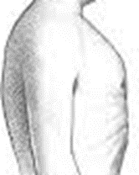
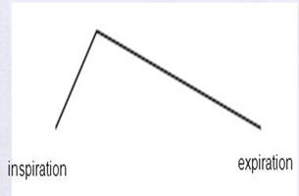
The following shape and breath sound were observed in this patient,

Slide 15
Q1: What’s Your Comment?
Normal shaped chest, vesicular breath sound
Barrel shaped chest, bronchial breath sound
Barrel shaped chest, vesicular breath sound with prolonged expiration
Flat shaped chest, vesicular breath sound with prolonged expiration

Slide 16
Q2: Apical pulsation in this patient was absent, What is the most possible cause?
The patient is obese.
He has dextrocardia.
He has emphysema.
He has pericardial effusion.

Slide 17
Q3. Which of the following is true regarding the role of chest x-ray in evaluating a case of COPD?
Used to confirm the diagnosis.
Reflects the severity of the disease.
Used to assess complications
Not useful in assessment of acute exacerbations

Slide 18
ABG Analysis
pH | 7.30
PaCO₂ | 72
PaO₂ | 42
HCO₃ | 35
SaO₃ | 84

Slide 19
Q4: What is the interpretation of these arterial blood gases?
Normal ABG analysis.
Type I respiratory failure.
Type II respiratory failure with normal acid-base status.
Type II respiratory failure with respiratory acidosis.

Slide 20
Q5. Which of the following is the target oxygen saturation (SpO2) in a COPD patient receiving supplemental oxygen?
80-85 %
85-90%
90-92%
92-95%

Slide 21


